Slide 1


Instacart Data Analysis
Project Presentation
Presented By,
Group 1
Akshaya Srinivasan
Manisha Paliwal
Praphul Kenkere Omkarmurthy
Sonal Sharma
https://cdn.outsource2india.com/featured-images/outsource-market-basket-analysis-services.jpg

Slide 2

Project Background
What?
Analyze 3 million grocery orders from more than 200k Instacart users to see which previously purchased item will be in user’s next order, segment similar customers, predict reorders and churned customers
Why?
To study customer purchase patterns, better product marketing and cross-selling
Solution needed?
Market Basket Analysis, Customer Segmentation and Reorder Prediction
Performance
Using Data Mining, build various models and evaluate performance

Slide 3
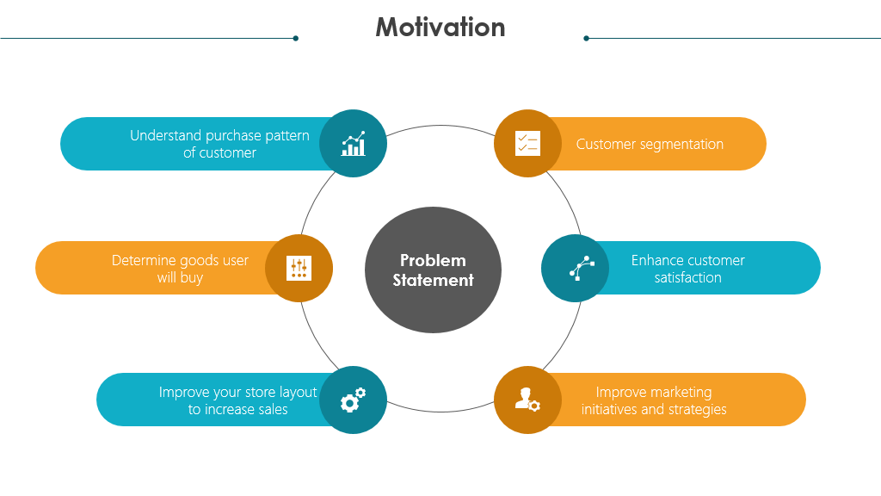

Slide 4





Executive Summary
Instacart Data Analysis
1
Store
134
Aisles
21 Departments
Data Collection & Pre-Processing
Exploratory Data Analysis
206209
Users
49688 Products
3421083 Orders
Market Basket Analysis
Data Preparation
Customer Segmentation
Data Preparation
Reorder Prediction
Data
Collection
Data
Pre-Processing
Data Transformation
Train-Test
Split
Evaluation & Conclusion

Slide 5

Literature Survey
Paper Title, Author and Publication | Objective | Methodology Used
Market Basket Analysis with Data Mining Methods by Andrej Trnka | This paper describes the way of Market Basket Analysis implementation to Six Sigma methodology. | General Rule Induction algorithm to produce association rules between products. To show the dependence between the products, Web Plot is used. C5 algorithm was used to build rule-based profiles.
Trend Analysis of Association Rules in Different Time Periods by Ansari | Discovering association rules that display regular cyclic variation over time. | Eliminated less frequent items from the dataset by setting minimum threshold. The results can be used in cross-selling recommendation and to enhance marketing strategies. MCAR and CPAR algorithms were used is comparison with associative classification.

Slide 6

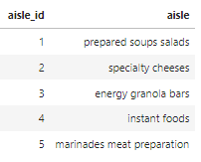
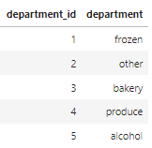
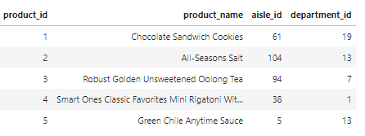
Data Collection
Defining Data Collection Requirements​​
Samples of Raw Data
There are total 134 unique aisles like frozen meat, milk, oil, cereal to name a few
There are 21 unique departments like bakery, alcohol, pantry, snacks etc.
There are a total of 3421083 orders made by 206209 users
The total orders per customer ranges from 0 to 100
Majority of the orders are made during day time
There are a total of 49688 products. The number of products in each aisle and department is different

Slide 7
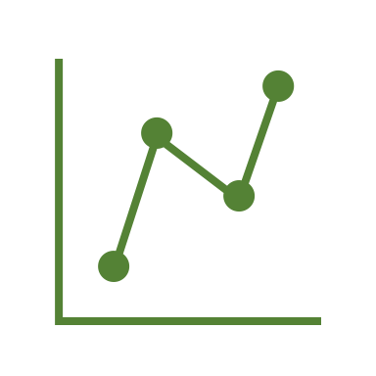
Data Pre-Processing
Merging the Datasets
Removing Missing Values
Exploratory Data Analysis
Merge orders, department, aisles and products data to create one normalized dataframe
days_since_prior had NaN values when multiple orders were placed on the same day. These NaN values were replaced with 0
Performed Univariate analysis by checking the descriptive statistics and understanding the data distribution
Most of the features had almost normal or skewed normal distribution
Handling Outliers
Principal Component Analysis
We identified outliers as those values which lied beyond their respective IQR range
3 features had approximately had less than 2% outlier values and they were removed from the analysis
Depending on the fields used on each analysis, PCA was used to reduce dimensionality and retain features that represent greater ~80% variance
Encoding Categorical Values
According to the analysis performed, categorical values were binarized/ ordinally encoded

Slide 8
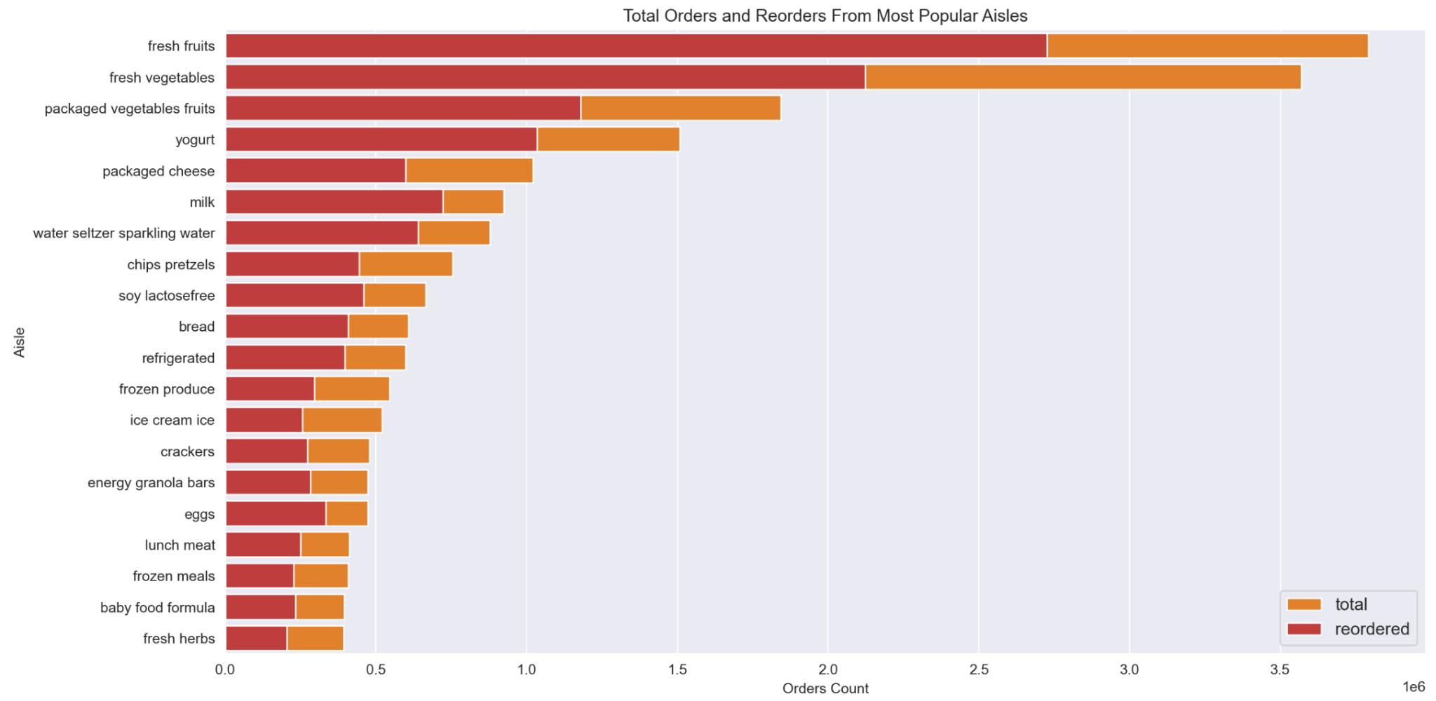
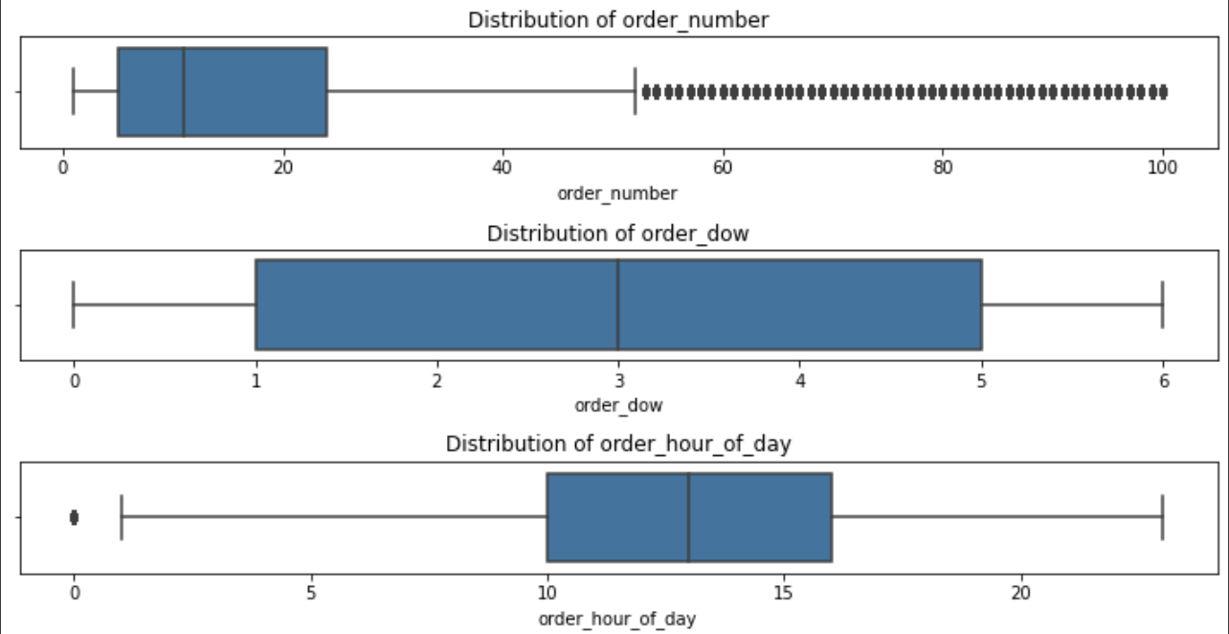
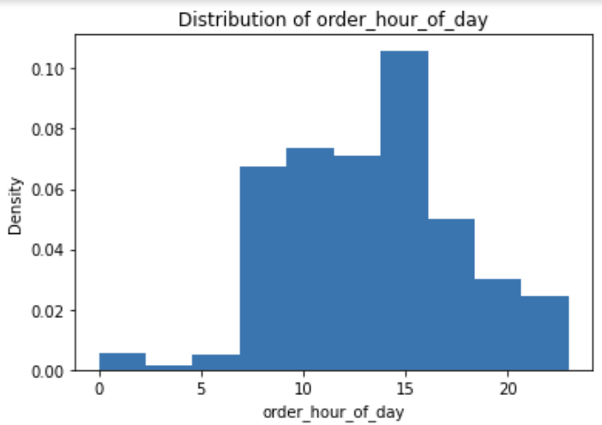
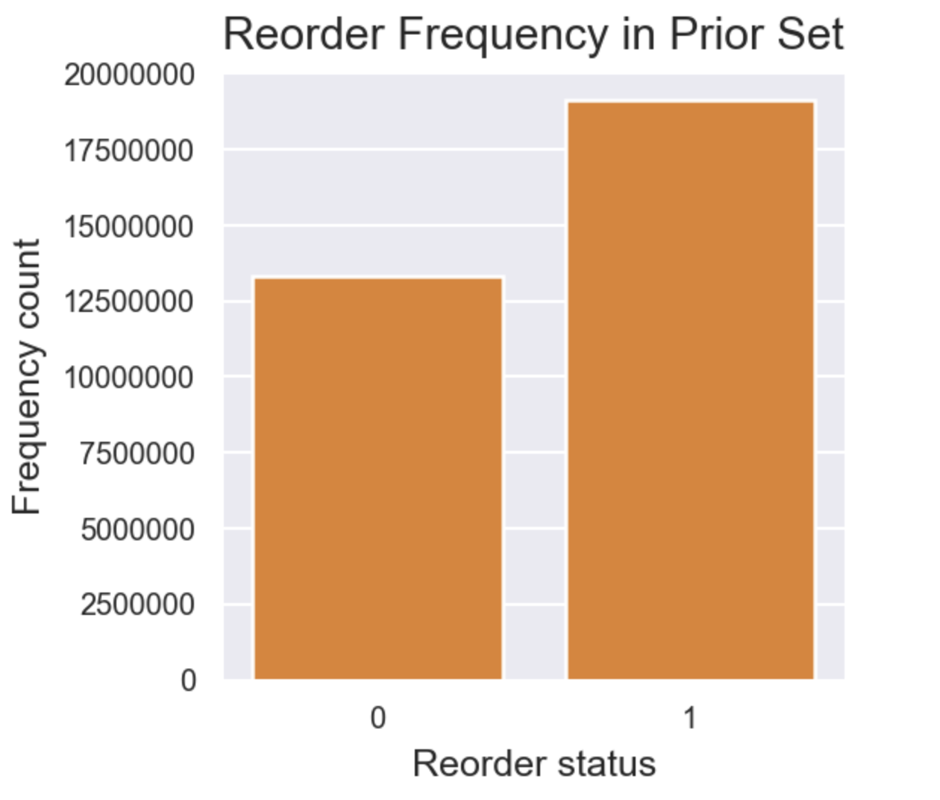
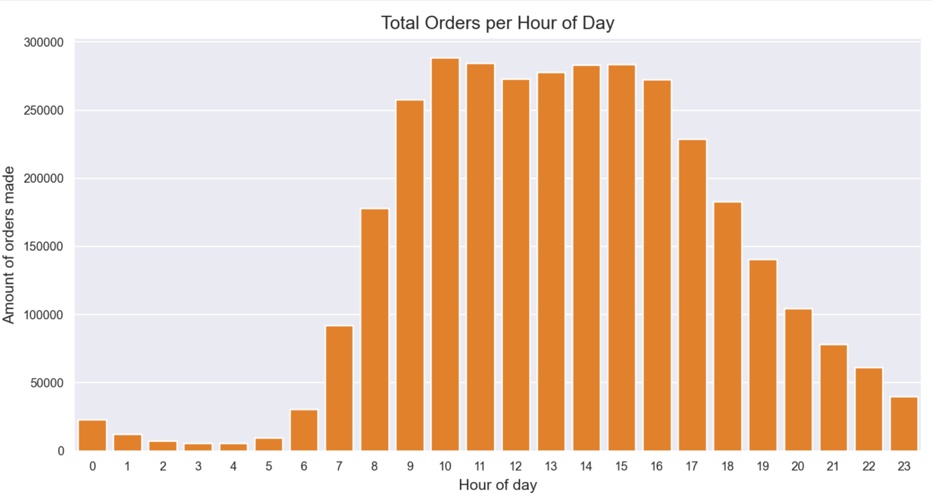
Data Pre-Processing

Slide 9

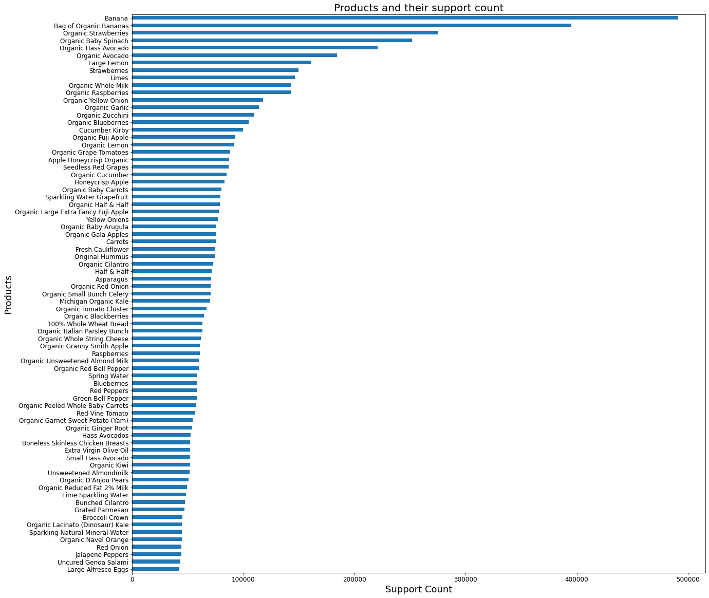
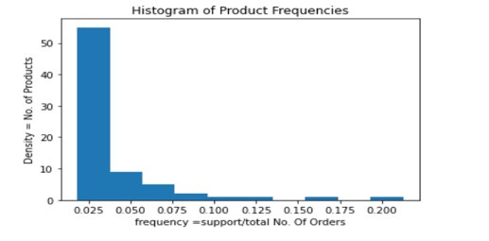
Market Basket Analysis
Product Specific Analysis
MBA based on products helps determine which products can be kept together/nearer than others for maximum sales in a store
Find most popular selling products based on support count
Find the range of support and their respective frequencies

Slide 10
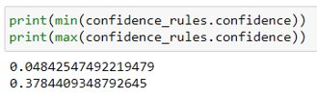
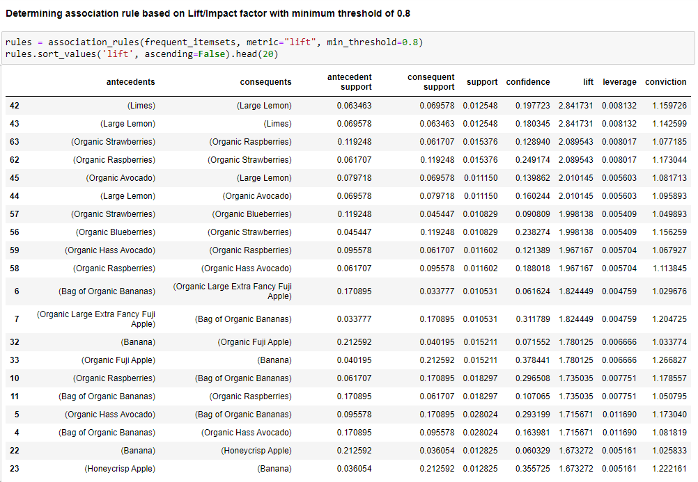
Market Basket Analysis
Product Specific Analysis
Using apriori method identify associations between the top 75 most frequent products​
Using confidence level : Association between products is very low with maximum value at 37% ​
Using Lift with threshold of 0.8: 66 product pairs were determined​
Top 20 product pairs with highest lift are as shown​
Limes and lemons are mostly purchased together​
Organic fruits are most associated with each other

Slide 11
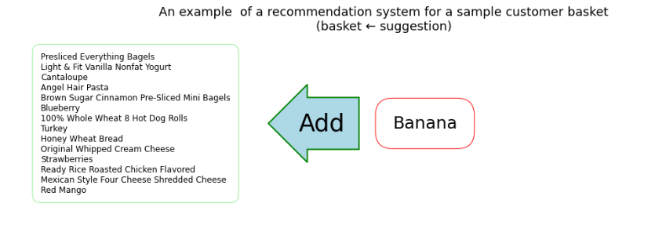
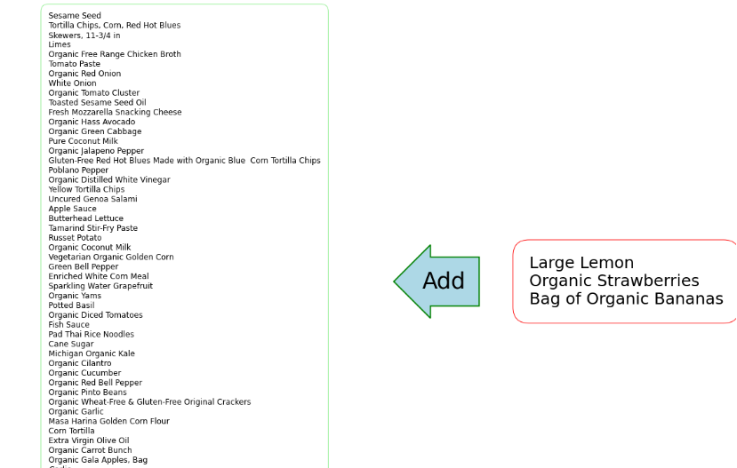
Market Basket Analysis - Recommendation
Basket ← Suggestion
Sample recommendation system is built using fpgrowth with confidence of 80% ​
Recommendations are generated as shown in example below​
Based on products existing in a basket , the system provides list of recommended products that can be added

Slide 12
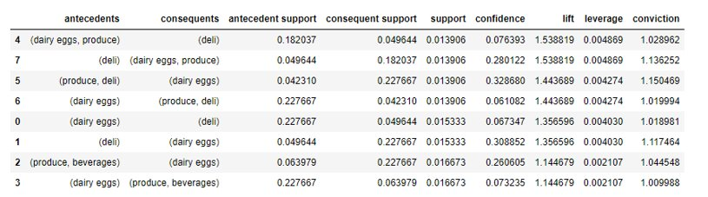
Market Basket Analysis
Department Specific Analysis
When opening a new store, it helps to determine a superset of products ( categorized as departments) that are closely associated to determine primary and supporting categories that can be incorporated in store
Using apriori method identify associations between 20 departments that were available in dataset​
Using Lift with threshold of 1, 8 department pairs were determined​
Out of 20 departments we see dairy eggs , deli and produce are closely associated , followed by beverages

Slide 13
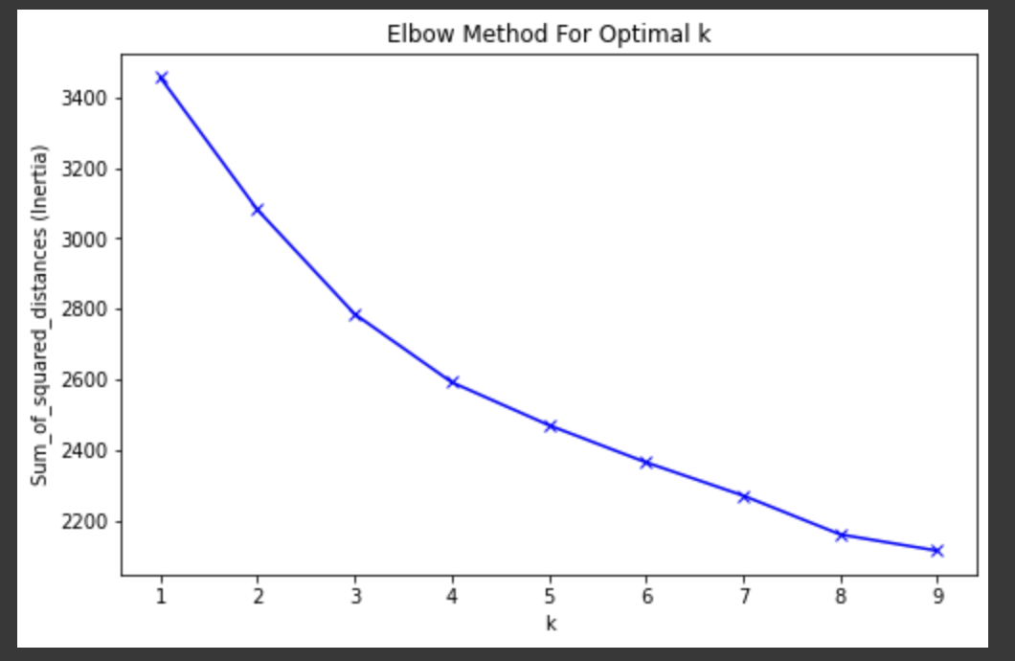
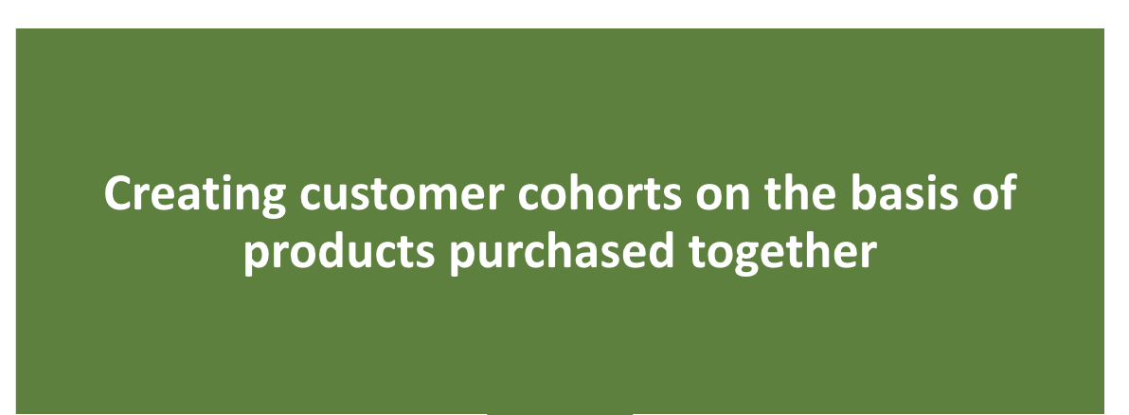
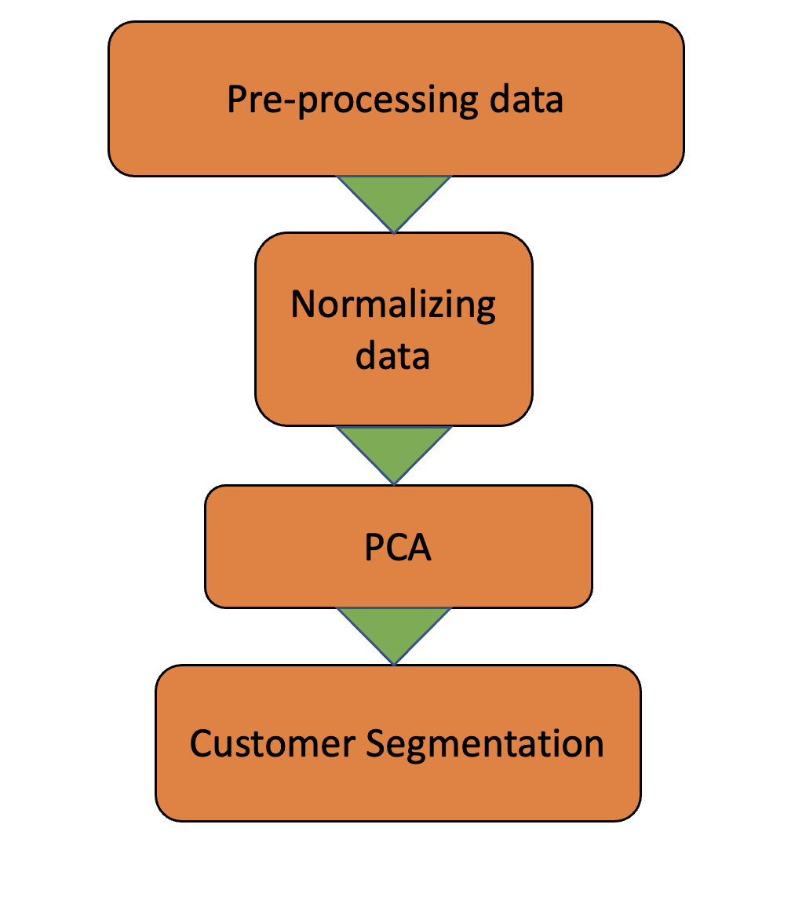
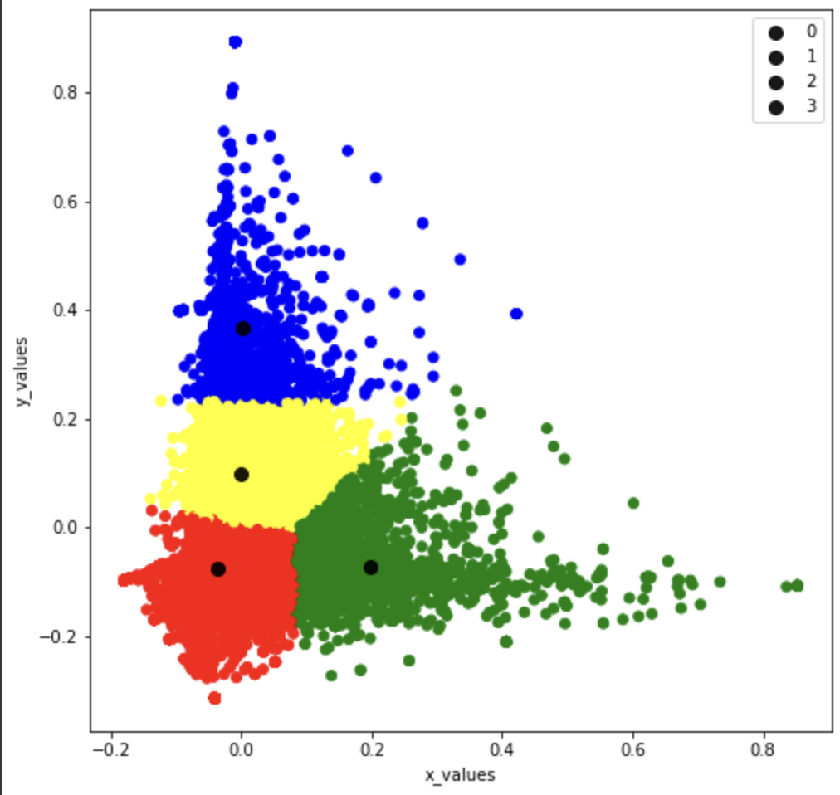
Customer Segmentation
K-Means Clustering with 4 clusters

Slide 14
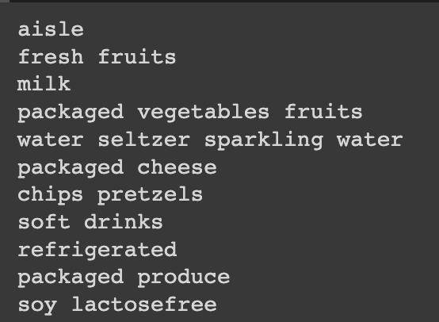
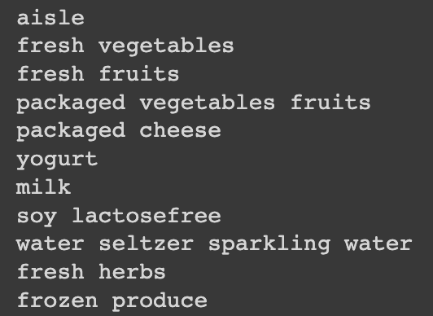
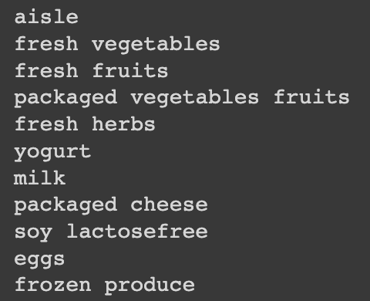
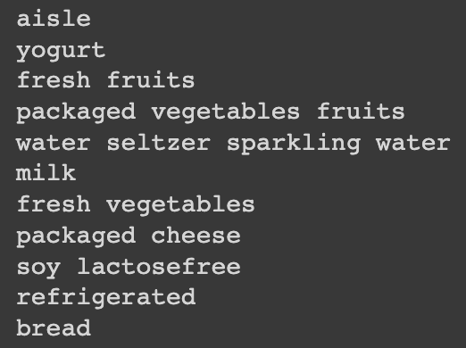
Top ten aisles for each cluster
C0
C1
C2
C3
Companies can target products from soft drinks aisles to customers in the first cluster, since it’s one of the top purchased aisles
Similarly, Eggs is one of the top aisles only for Cluster 2. Hence, customers from cluster 2 can be targeted with ads for the same, and be recommended with products from the eggs aisle

Slide 15
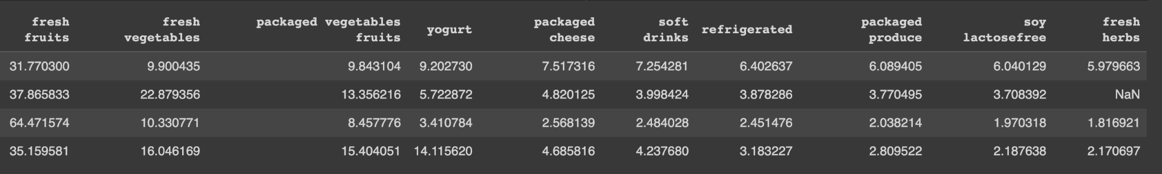
Customer Segmentation - Insights
Closer inspection suggests that fresh fruits and fresh vegetables are among the top selling aisles across all clusters
Companies to target customers by recommending them products from both most and least sold aisle
In cluster 3, products from soy lactose free is the least sold aisle, companies can leverage this insight to increase the sales of the least sold product by recommending such items

Slide 16

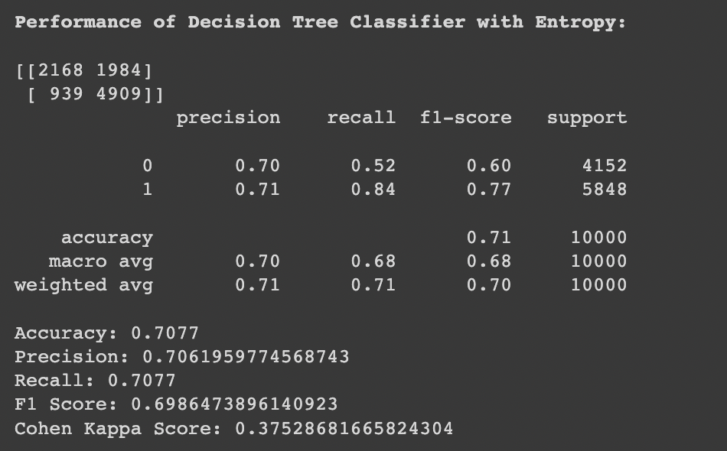
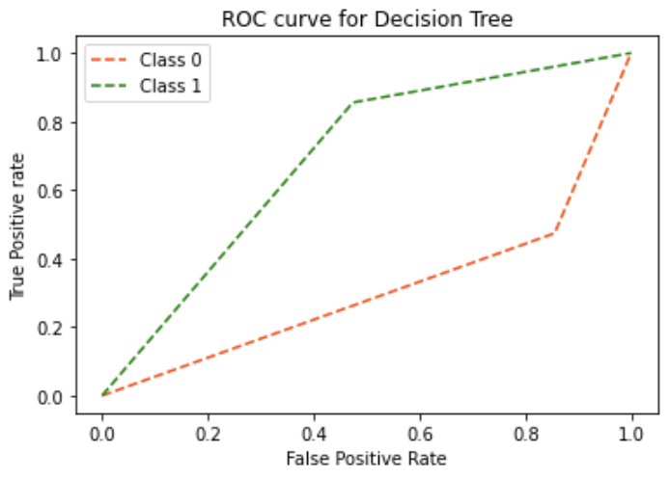
Reorder Prediction Using Classification
Data Preprocessing
Merging all datasets
Ordinal Encoding
Stratified sampling on user_id
Standardize the data
Feature Selection using RFE (Random Forest as base model)
Dimensionality Reduction using PCA
Decision Tree Classifier
Selected the best parameters using hyperparameter tuning and k-Fold cross-validation
Accordingly, pruning the tree to a depth of 10 and using entropy as the impurity measure worked best for this case
Best combination of parameters: max_depth = 10, min_samples_leaf = 50, criterion = entropy
Achieved an initial accuracy of 64% and a final accuracy of 71% after hyperparameter tuning

Slide 17
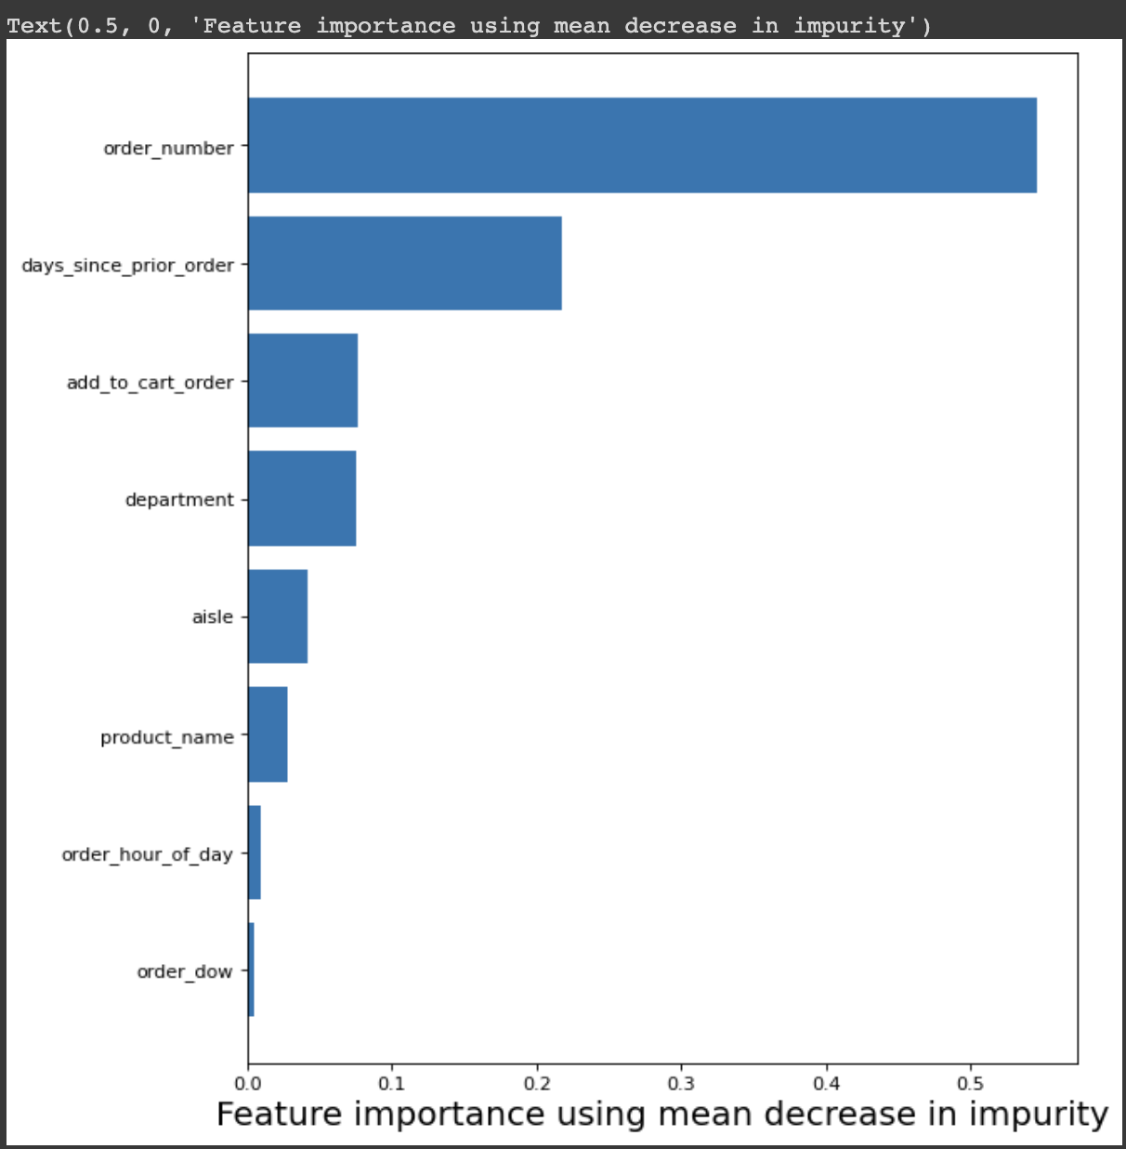
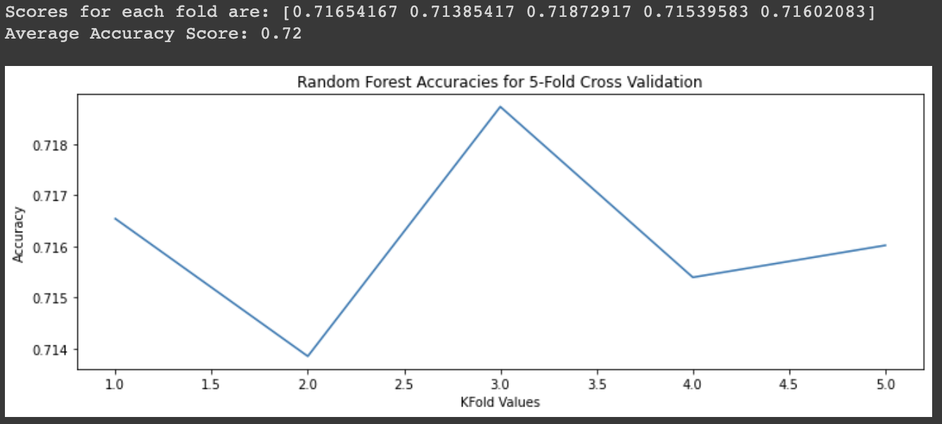
Machine Learning Models
Random Forest Classifier
Selected the best parameters using hyperparameter tuning and k-Fold cross-validation
Best combination of parameters: max_depth = 10, min_samples_leaf = 50, criterion = entropy
Achieved an initial accuracy of 69% and a final accuracy of 72% after hyperparameter tuning

Slide 18
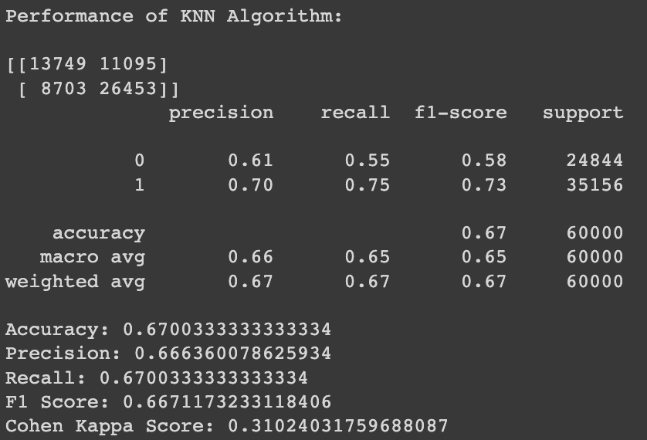
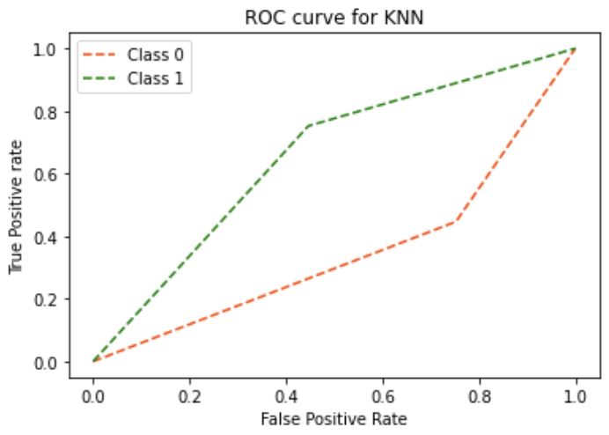
Machine Learning Models
K-Nearest Neighbor Classifier​
Identified 3 as the optimal value of k and the Euclidean as the distance metric using hyperparameter testing and validation
Observed an initial accuracy of 63% and a final accuracy of 67% after hyperparameter tuning
Comments
The data volume is ~32M, hence we experimented with all the models with a sample size of ~1M and ~3M, and the best performance was observed for the ~3M sample
We used precision, accuracy, recall, F1 score and AUC -ROC curve to evaluate model performances. Random Forest proved to be the best performing model with an accuracy of 72% for this data and use case
Identifying customers who will reorder helps companies in optimizing their marketing strategy and take up retention actions.
Although we see day of week, and hour at which the order was placed has significance on the number of orders placed (from EDA), they do not specifically have significance towards reordering of items

Slide 19

Conclusion and Future Work
Conclusion
Market Basket Analysis, Customer Segmentation and Reorder prediction can all be instrumental for companies like Instacart to improve their retail presence with such basic order, user and product data
Market Basket Analysis helps in identifying products that can be recommended to customers and gives insights towards product placements in the store for the shops. While the latter is not in the control of platforms like Instacart, recommendation is something they can certainly do
Customer segmentation helps in identifying customers that have similar preferences, and hence can be targeted with ads that have similar motives
Reorder prediction helps largely for shops to forecast demand of products and identify customers who might churn and will need to be targeted with retention activities
Future Work
While the Ensemble model such as RF has outperformed DT and KNN, there is further scope in increasing the reorder prediction model accuracy. Stratifying reorder prediction by department might help in better identifying order patterns
Although more resources are required, batch processing can be used to help the model learn from all the available data
THe performance of K-Means clusters generated can be tested further with newer data

Slide 20
Contribution of Team Members
Task | Primary Members | Reviewing Members
Problem Definition and Data Collection | Akshaya, Manisha, Praphul, Sonal | -
Brainstorming for Approach | Akshaya, Manisha, Praphul, Sonal | -
Data Pre-Processing | Praphul, Akshaya | Sonal, Manisha
Market Basket Analysis | Manisha, Akshaya | Praphul, Sonal
Customer Segmentation | Sonal, Praphul | Akshaya, Manisha
Reorder Prediction | Akshaya, Sonal | Manisha, Praphul
Conclusion and Documentation | Akshaya, Manisha, Praphul, Sonal | -

Slide 21
Thank You!

